Slide 1
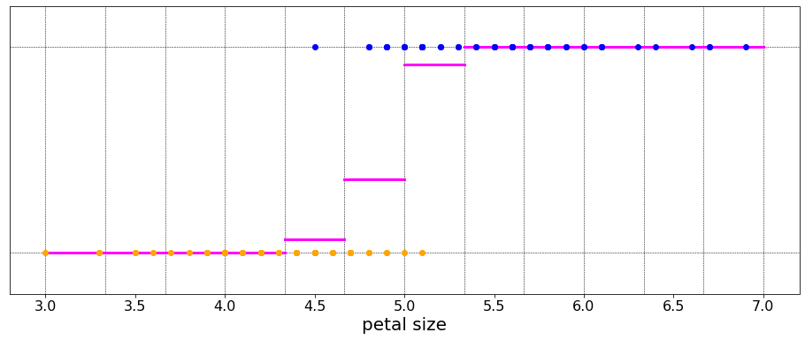
virginica
versicolor
bin 0
bin 1
bin 2
...
Notes:
Imagine now that you had to guess whether an unseen flower was a versicolor or a virginica based only on its petal length. A reasonable way to go about this would be to go back to the dataset and find all flowers with similar petal lengths, and then decide by majority vote.
Here is an illustration of such a strategy.
First we grid the petal length space into some number of bins. Then we count the number of each type of flower in each bin. The horizontal pink lines here represent the probability that a flower taken from that bin is virginica. And it is computed as follows:
The probability that the outcome Y equals virginica given that we are sampling from bin i equals the number of virginica flowers in bin i divided by the total number of flowers in bin i.
The probability that the flower is a versicolor is of course just 1 minus this quantity.
As we move from left to right, from smaller to larger petal lengths, we will expect the probability of virginica to rise from zero to one, just as we expect the probability of versicolor to decrease from 1 to 0.
The threshold petal length separating virginica and versicolor flowers should then be placed at the bin corresponding to equal parts of the two flower types. That is, where the probability equals 0.5,

Slide 2
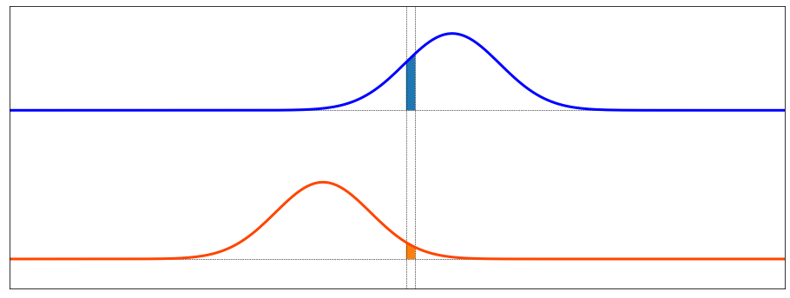

type 1
type 0
Notes:
We are now going to formalize the example. Instead of the species of flower, we will refer to output class Y.
We will use class names 0 and 1, instead of versicolor and virginica.
And instead of petal length, we will consider some arbitrary feature called capital X.
To derive logistic regression we will begin by assuming that the marginal distribution of X – remember X is akin to the petal length – for each of the classes 0 and 1 are Gaussian.
In formal notation, this means that probability of X given Y=0 is normally distributed with mean mu 0 and variance v0 squared. And the probability of X given Y=1 is normally distributed with mean mu1 and variance v1 squared
Furthermore, we will assume that the two variances are the same: v0 squared equals v1 squared, and we will denote both of them by v squared.
Let's now do the same thing we did before; let's look at a narrow bin and find the probability that the items within that bin are of type 1

Slide 3
1
=
+
1 +
/
Notes:
This probability will turn out to be very important, so we are going to give it its own symbol sigma. This might be a little confusing because we had previously used sigma for the standard deviation. But the reason will soon become clear.
Alright, just as before, this probability is the ratio of the number of items of class 1 divided by the total number of items. This equals the ratio of the blue shaded area divided by the sum of blue and orange.
if we now divide the numerator and denominator by the blue area, we see that sigma will depend only on the ratio of the two areas: blue divided by orange.
Let’s focus on that term.

Slide 4
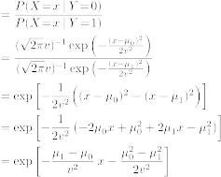
Notes:
In fact, this ratio is an important quantity with its own name: the odds ratio.
Next we use the assumption that the marginal distributions are gaussian. We plug the formula for the gaussian distribution into the numerator and denominator of the odds ratio, keeping in mind that they have different means, mu0 and mu1
Because the variances were assumed to be the same, they cancel out, and we are left with a single exponential function of the difference between two squares: x minus mu1 squared, and x minus mu0 squared.
After a couple more lines of algebra, we arrive at our conclusion: that the odds ratio is equal to an exponential of a linear function of x.
Well that’s a mouthfull, let’s take a closer look.

Slide 5
odds ratio :
where :
Notes:
The odds ratio equals an exponential: e to the minus z where z is a linear function of x with coefficients beta 0 and beta 1.
Furthermore, we can compute these betas from the parameters of the marginal distributions, mu0, mu1, and the common variance v squared.

Slide 6
logistic function :
Notes:
Ok, we can now use this expression for the odds ratio to complete our formula for sigma, and so we get that sigma of x equals 1 over 1 plus e to the minus z, where z equals beta 0 plus beta 1 times x.
This function is known as the sigmoid function, because of its similarity to a letter S. Hence the letter sigma.
It is also known as the logistic function.

Slide 7
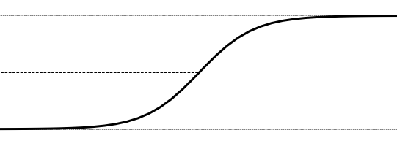
Notes:
Once we have found the particular logistic function that best fits our data, we can then use it to compute the threshold that separates the two classes.
Let’s call this threshold x bar.
As we said before, we choose the threshold such that the probabilities of each class are the same and equal to 0.5, so sigma of x bar must equal 0.5
Plugging this into the formula, we get that z bar must equal 0 since e to the 0 equals 1.
And so beta 0 + beta1 xbar must equal zero, and therefore the threshold xbar equals negative beta 0 over beta 1.

Slide 8
Approximate solution:
… sample mean class 1
… sample mean class 2
… average sample variance
Notes:
Next we will address how to obtain the betas.
We already derived some formulas, but only by making some pretty broad assumption. We assumed not only that the marginals were Gaussian, but also that we know their mean and variance, and that the variances are equal.
We don’t know these quantities, but we can approximate them with the sample means and variances. Let’s call this the approximate solution.
In the real world this approximate solution will take us only so far. We will soon be extending this method to cases where no closed-form solution exists, and we will need a more powerful tool for computing the betas.
For this we will adopt the same approach as we have seen before with other models such as linear regression. That is, we will formulate logistic regression as an optimization problem.
Let’s do that.

Slide 9
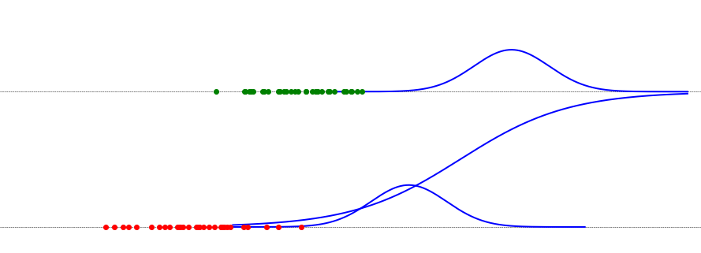
Logistic regression via Maximum likelihood
Notes:
The cost function that we will use to chose the parameters beta0 and beta1 is the likelihood function.
Here is how it is defined.
The likelihood of a set of parameters – in this case beta 0 and beta 1 – is the probability that the dataset that we have observed could have been generated by the model implied by those parameters.
Let’s look at an example. Here we have a dataset with measurements of two classes, green and red. What is the likelihood of this candidate logistic function?
Well, this function implies the green and red marginal distributions that are well to the right of the data the we have. It’s not that it is impossible that this dataset could have arisen from the blue model, it’s just very unlikely.
So this logistic function, parameterized by our candidate beta 0 and beta 1, has a very low likelihood.

Slide 10
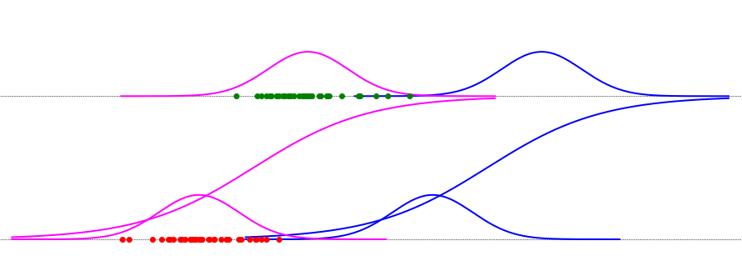
high
likelihood
low
likelihood
Notes:
This pink model, on the other hand has a higher likelihood, and our objective will be to find the model with the highest likelihood, given the data.

Slide 11
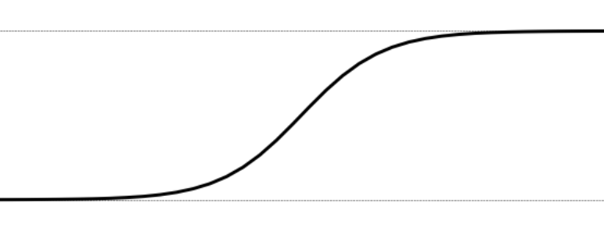

Likelihood:
Notes:
To quantify the likelihood of a candidate beta 0 and beta 1, we take the product of the probabilities of the data samples according to those parameters.
In this example, the probability of the red point of class 1 is sigma and of a green point of class 0 is 1 minus sigma. So we take the product of 1-sigma of xi for all green points, and multiply that by the product of sigma of xi for a red points.
If we assign a class label of zero to green and 1 to red, then we can express this as a single product of 1-sigma(xi) to the 1 minus yi times sigma(xi) to the yi.
Capital N in this formula is the number of samples.
Take a moment with this formula to make sure that you understand why it is true.

Slide 12
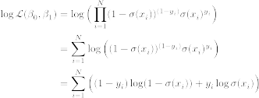
Notes:
The next step is to take the logarithm of both sides. This has the beneficial effect of converting the product into a sum, and it has no effect on the result.
Then using the properties of logarithms, and with a couple lines of algebra we get to the final objective function for our optimization
That is the sum over the data of one minus yi time log of 1 minus sigma + yi times log of sigma.

Slide 13

Cross entropy
Notes:
This formula is known to information theorists as the cross entropy, or rather the negative of the cross entropy. So we will adopt that name. Instead of maximizing the likelihood, for classification problems we minimize the cross entropy.

Slide 14

Optimization problem for logistic regression
Notes:
And here is the complete optimization problem for logistic regression. It reads: find beta 0 and beta 1 that minimize the cross entropy, defined as the negative of this formula involving sigma, where sigma is defined as the logistic function.

Slide 15
Notes:
So to summarize, in this video we have derived a formula for the sigmoid or logistic function which will serve as a basis for simple classification problems. We've posed the problem of selecting the parameters of the model as an optimization problem in which we minimize the cross-entropy.
That’s it for basic logistic regression. In the next couple of videos we will learn about extension of this technique to problems with
a) more than one input or feature and
b) more than two classes
see you then.

